Slide 1


Data Science Framework Report Mauricio Carvajal

Slide 2

Agenda
Problem statement
Proposal data science process framework
Data management
Risk management
Insights

Slide 3

Problem statement
Over the past year or so Credit One has seen an increase in the number of customers who have defaulted on loans they have secured from various partners, and Credit One, as their credit scoring service, could risk losing business if the problem is not solved right away.

Slide 4
Goals
Provide a robust model to predict the default payment on clients
Analyzed and understand what are the current situation of the bank
Base on data, recommendations on how improve the current situation

Slide 5
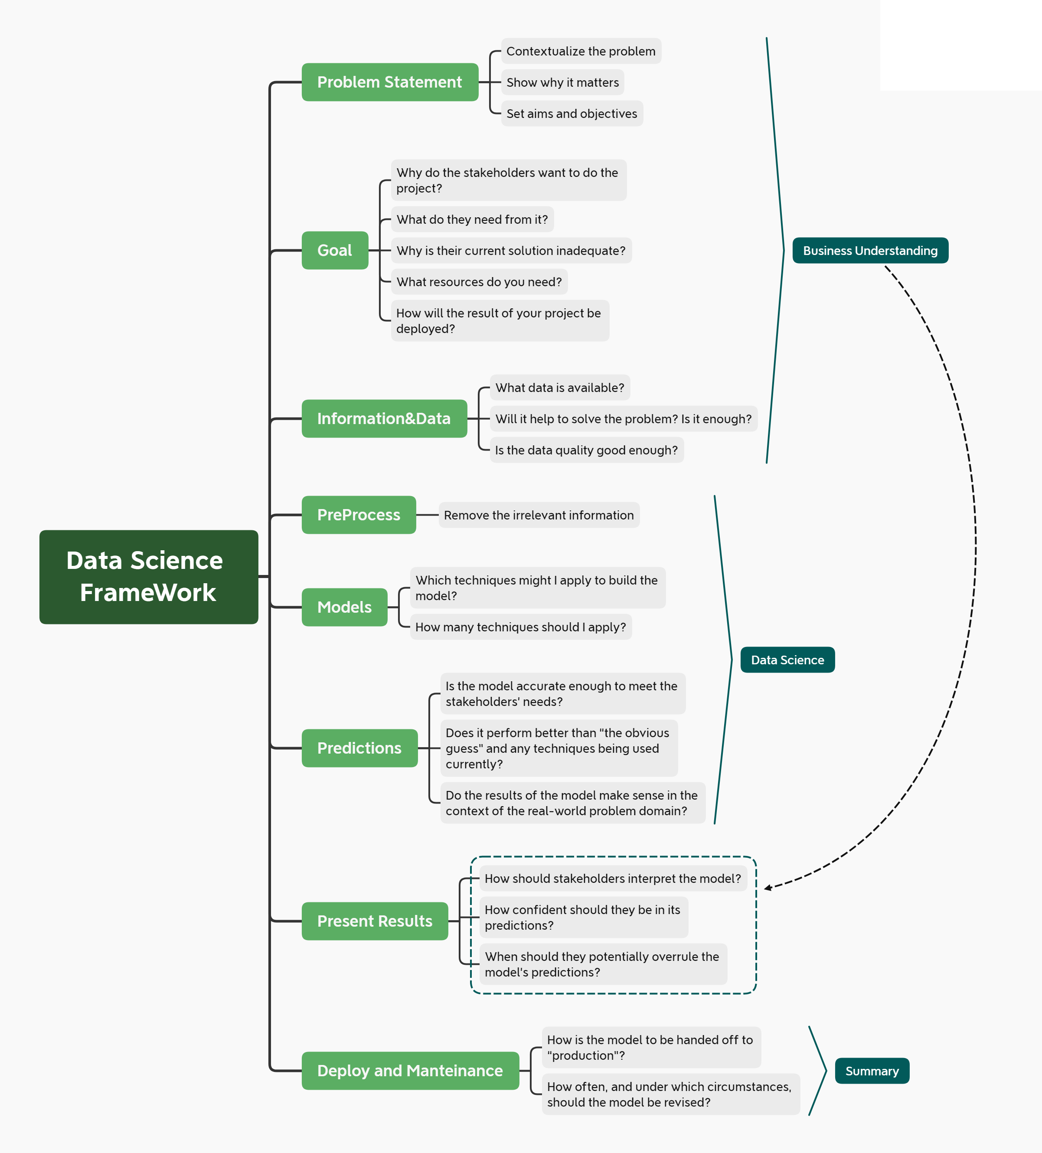
Data Science Framework
Base on the model :
Zumel and Mount
Divided in 3 groups:
Business understanding
Data Science (data manipulation)
Deploy and maintenance

Slide 6
Data Science Framework (Business understanding)
Problem Statement:
increase in the number of customers who have defaulted on loans that will potential causes serious problem to the bank.
Goals:
Analyzed what features are producing the clients defaulted
Create a robust model to predict possible default clients
Provide recommendations on how to decrease the client default paument

Slide 7

Data Science Framework (Data science)
Data understanding:
First step is to understand the data, find if there any missing value, what represent the values, numerical, categorical, the information is relevant to the problem statement.
Pre-Process
Transform the data that is needed, is the data need to be escalated, or need to be reduced, maybe need to be binned
Feature engineering
Split the data sets, group by category, pre process it, maybe apply PCA for numerical values i.e amount of bill statement.

Slide 8
Data Science Framework (Data science)
Models:
Identify if is regression, or classification problem. i.e in this case is classification
Find a group of machine learning algorithms that preform well according with the size of the data set.
Evaluation
Use Accuracy, kappa, confusion matrix to evaluate how well the is the model.
Predictions
Base on the model and the results of the evaluation, make and evaluate the results of the perditions. This process can be iterative too.

Slide 9
Data Science Framework (Present results)
One the model is been proven the results is critical part for the successful of the project.
Use the learnings of the business understanding
Use a lot visualization rather to go technical
Try to use the best practices on “DATA TELLING”

Slide 10
Information of the data
Amount of the given credit
This is a numerical value, can be binned
Gender
Needs to convert to categorical value
Education
Categorical value, important to see if there any relationship between educational levels.
Marital status
Categorical
Age (year)
This is the age of the customer

Slide 11
Information of the data
History of past payment
Categorical value
Amount of bill statement
Numerical value, this can be reduced using PCA
Amount of previous payment
Numerical value, this can be reduced using PCA
client's behavior
This is the dependent value

Slide 12
Data Management
1- Understanding Data
Need to convert the data, numerical to categorical
2-Proproces the information
Find a method to discard irrelevant information
Correlation, PCA, Feature variance, recursive feature elimination
3- Find the best model
Use different machine learnings models: RF,SVM,KNN C5.0
Evaluate the best performance
Kappa, accuracy
4-Use the best model to predict the results define in our problem statement

Slide 13

Risk Data management
Change the customer sending habits is not posible
Need to have clear understanding of the type of the data.
Conversion from numerical to categorial as needed
Understand if the problem is classification or regression problem
The time that is needed to build the models
Human behavior is difficult to model

Slide 14

Initial Insights
History of previous behavior is key to create a model that can predict the possible behavior of the customer.
The age of the customer can another factor to take into consideration
Gender, can be risky to analyze this feature due to any discriminations in the findings.
The amount of given credit can be binned or grouped to have better understanding.
The age can be grouped as: Youth, youth Adult, Adult, Seniors.

Slide 15
Environmental changes
Python
For this project the idea is to migrate from r studio to Python.
Python is more widely known
Python have similar library “sklearn” as R Caret”.
Start using git
Starting implemented the best practices of the industry using Git.
Git: Control version system

Slide 16

Thank You
lmauriciocarvajal@gmail.com

